Slide 1

JavaScript
A language of all

Slide 2
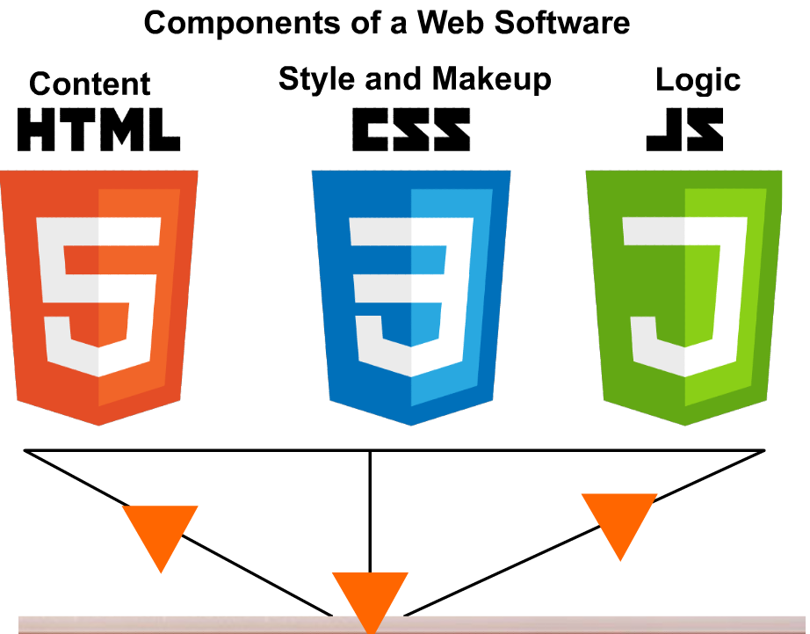

Slide 3
Why JavaScript can do?
Desktop applications
Web Sites
Android and iOS applications
Nodejs server development

Slide 4
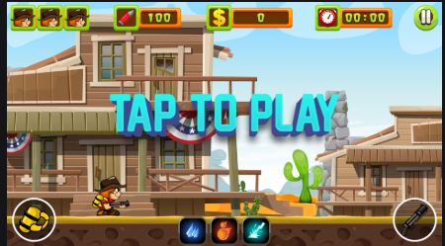
POSSIBILITIES

Slide 5
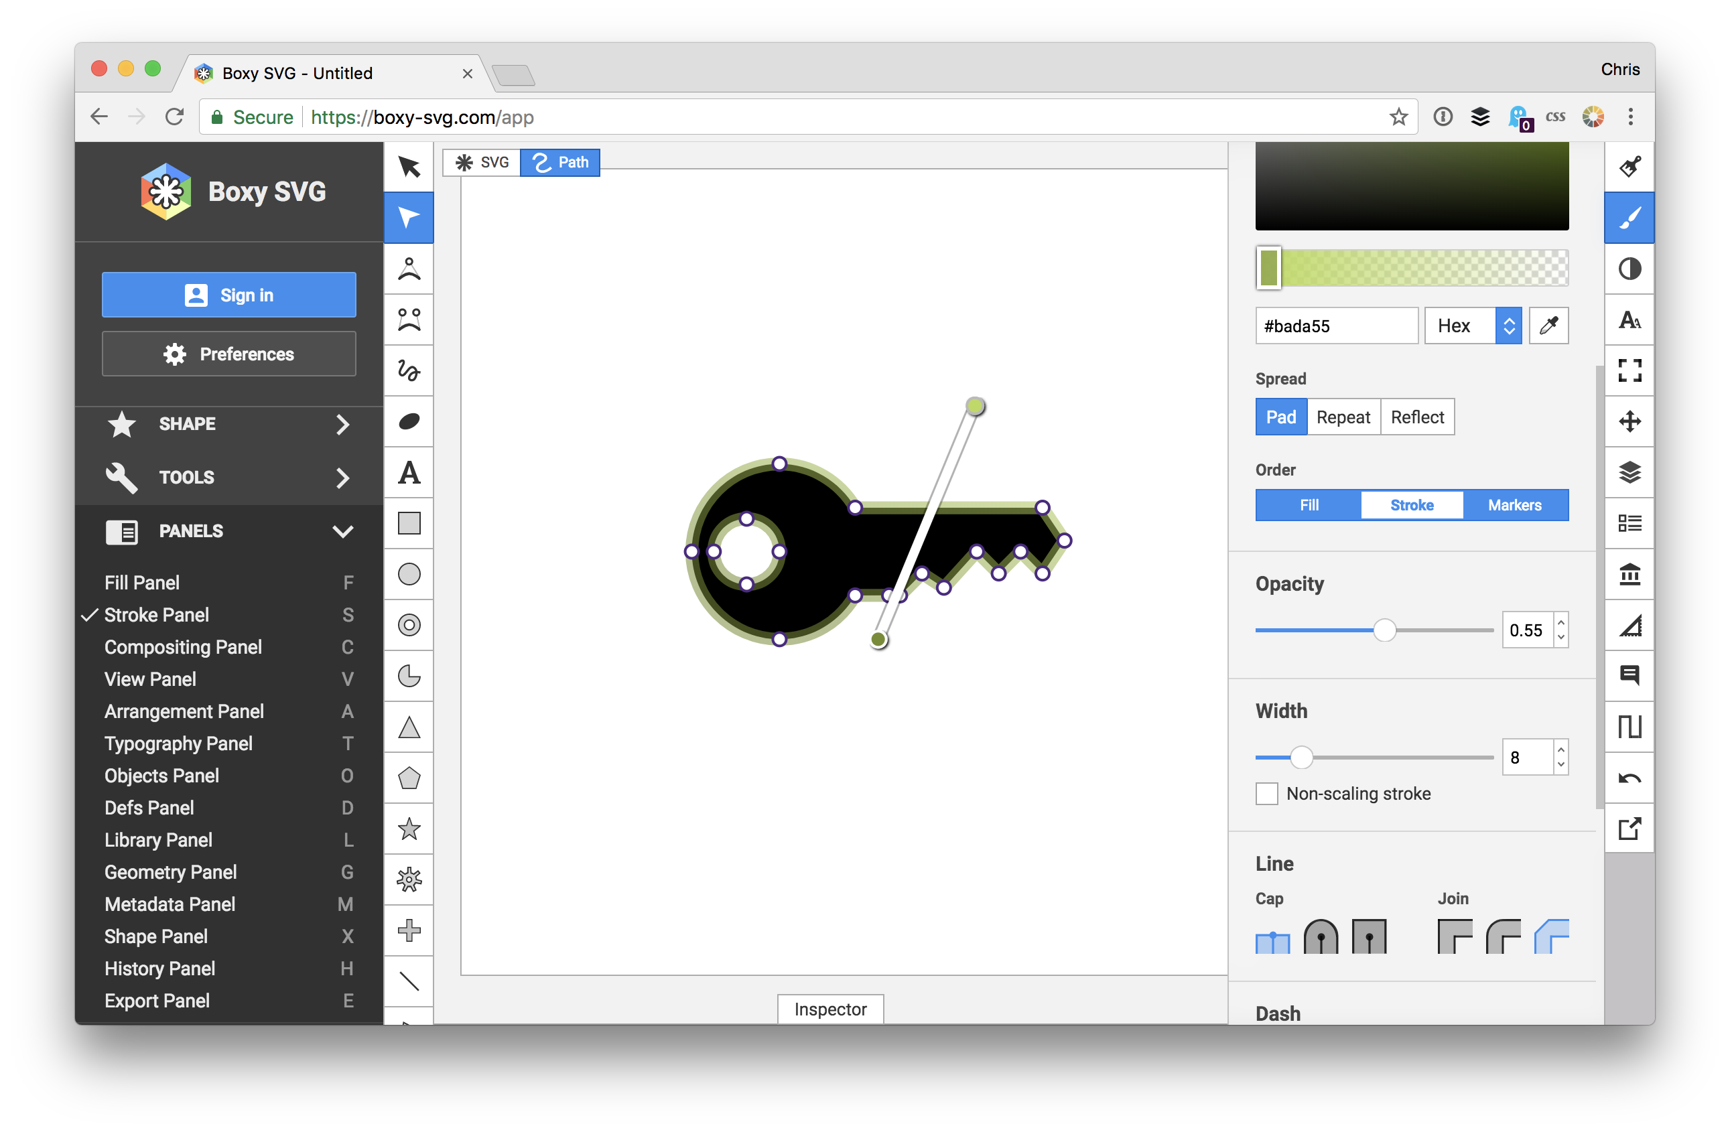
POSSIBILITIES

Slide 6
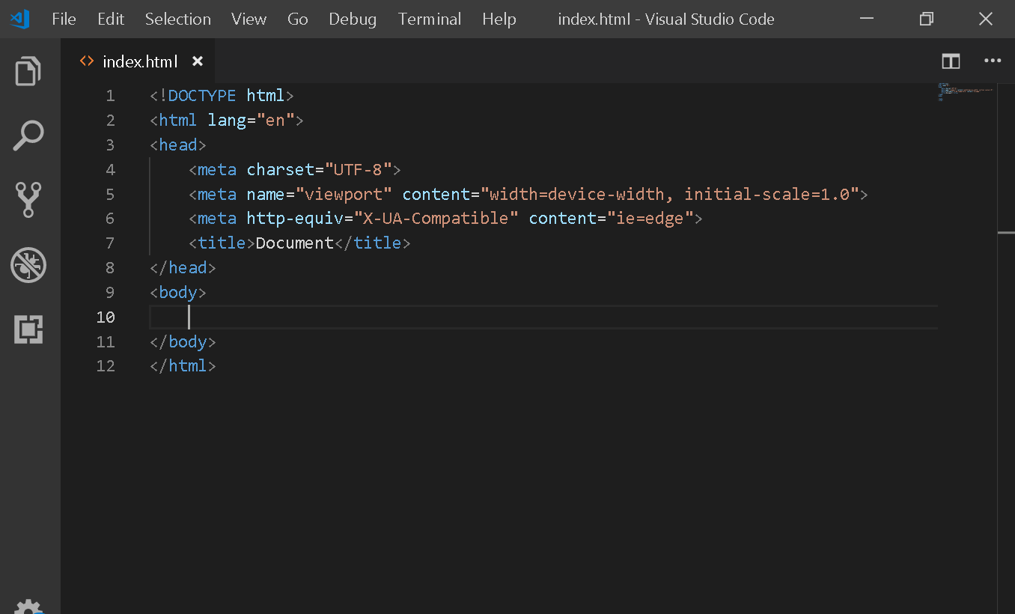
POSSIBILITIES

Slide 7
JavaScript
Conditional Structures
Repetition Structures
Labeled Structures
Data Structures

Slide 8
Getting started with JS
The story begins with variables and constants!
A way to store data for our application.

Slide 9
What is a program?
A sequence of instructions we provide to a specified system.

Slide 10
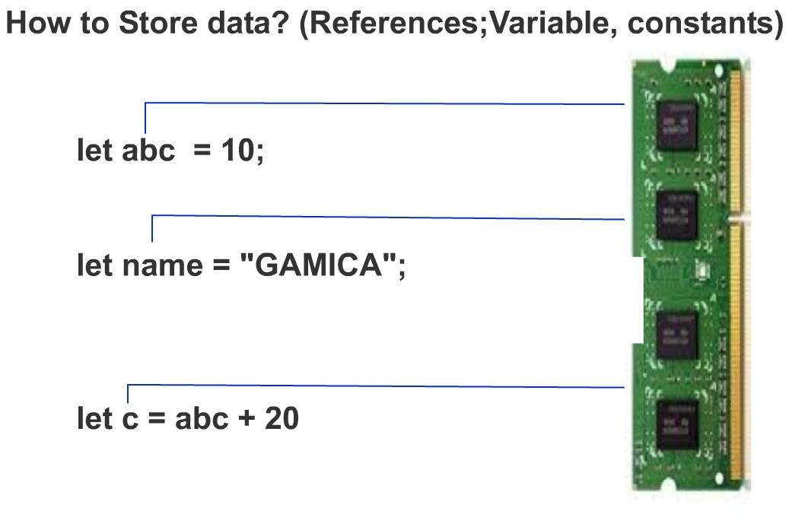

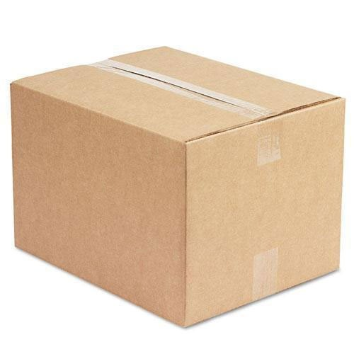
Variables and constants
let
let
const res

Slide 11
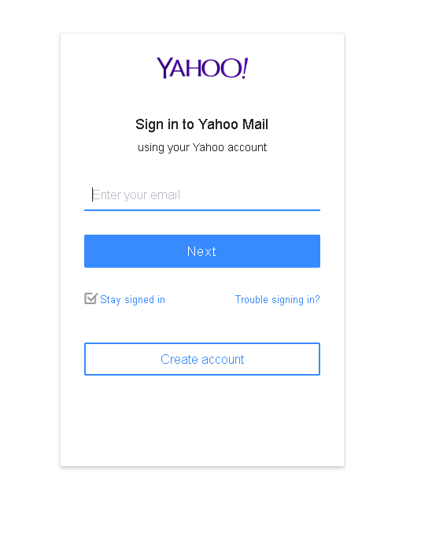
Variables
A variable which will store the data
entered in the textbox

Slide 12
Data Types
String > All characters, “adada3432$$%$%$2342”
let firstName = “Khurram”;
let lastName = “Raheel”;
let fullName = firstName + lastName; //Khurram Raheel

Slide 13
Other data types
Numbers > All numbers, “19,22.23, -2323, 0.20”
Boolean> true, false
Null> A space which is empty
Undefined> A thing which has not been undefined
e.g. let num;

Slide 14
JavaScript
Conditional Structures
Repetition Structures
Labeled Structures
Data Structures

Slide 15


Conditional Structures
If condition,
switches

Slide 16
If Conditions
num = 10;
if( num > 10){
alert(“Yes, It is big”);
} else{ alert(“No, It is not”);
}

Slide 17
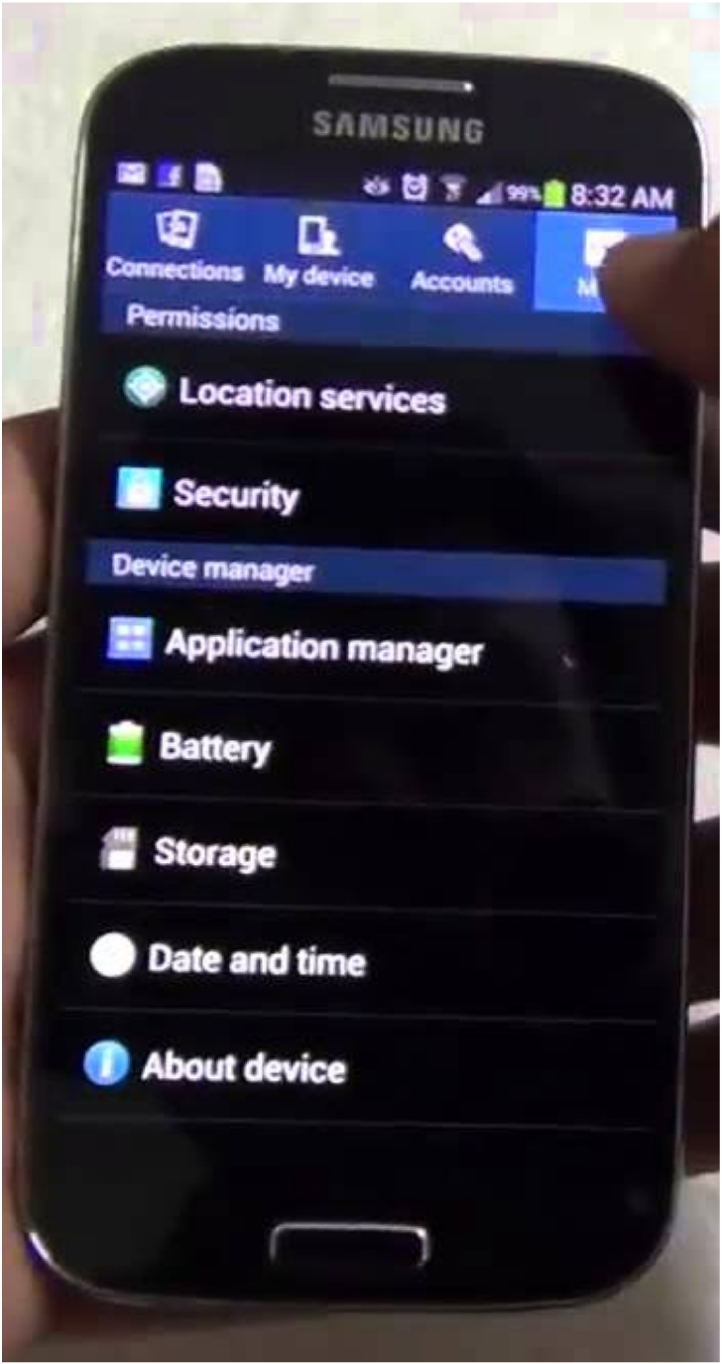
Conditional Structures
Switch
Location Services
Security
Application Manager
Battery
Storage
Date and Time
About device

Slide 18
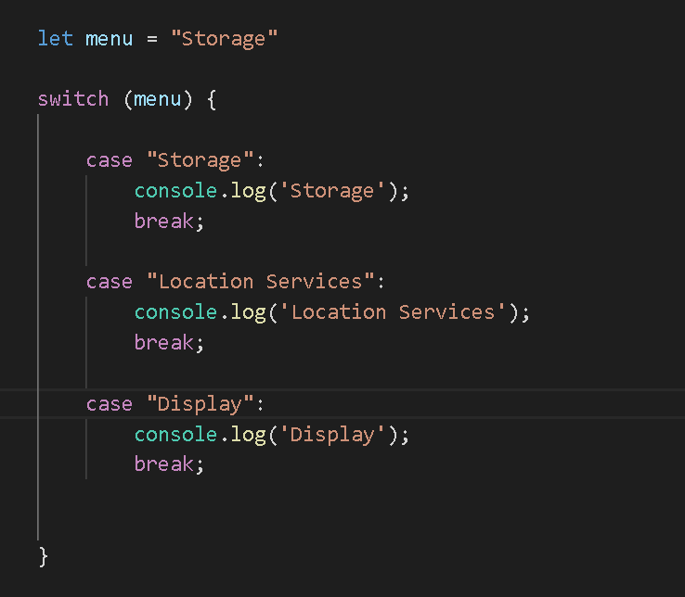

Slide 19
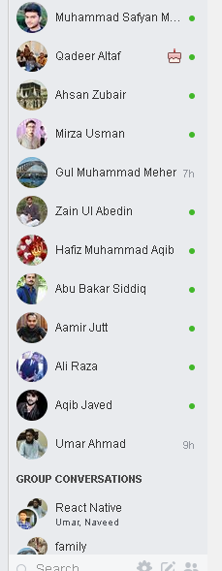
Repetition Structures
For counter loop
For in loop
For of loop
forEach loop

Slide 20
Labeled Structures
Functions
Classes

Slide 21
A program is a subset of small sub-programs!
Adobe
Photoshop
Program
Draw Shape
Create Layer
Delete Layer
Sub-Program
Sub-Program
Sub-Program

Slide 22

Function
1). A set of code which can serve as a machine i.e. it can take input and return some output 2). A function should perform only one action at a time
INPUT
OUTPUT

Slide 23
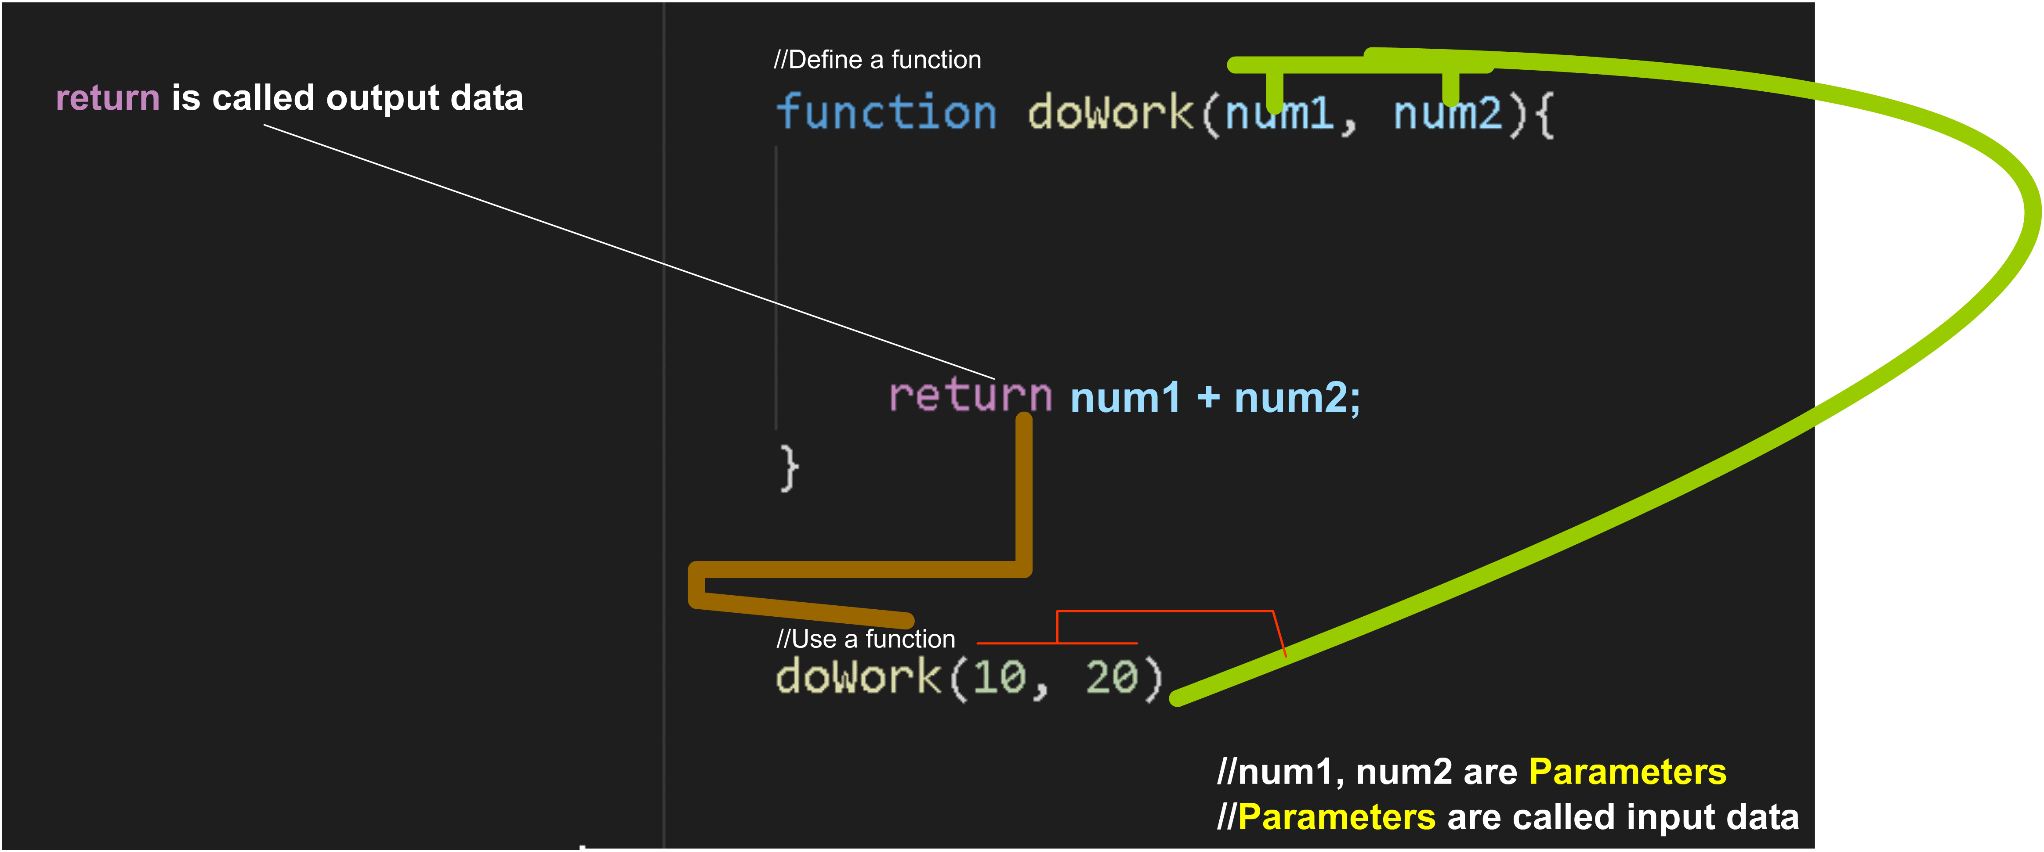

Slide 24

Understanding Access rules
let fruit = “apple”;
function showFruits(){ console.log(fruits); }

Slide 25
Understanding Access rules
let fruit = “apple”;
for (let num = 0;num<5;num++){ console.log(fruits); }

Slide 26


Understanding Access rules
for (let num = 0;num<5;num++){
let fruit = “apple”; } console.log(fruits);

Slide 27
Understanding Access rules
function showFruits(){
function getApple(){ console.log(fruits); }
console.log(fruits); }

Slide 28
Understanding Access rules
function showFruits(){
function getApple(){ console.log(fruits); }
console.log(fruits); }
getApple()

Slide 29
Understanding Access rules
function showFruits(){
function getApple(){ console.log(fruits); }
console.log(fruits); }
getApple()

Slide 30
Data Structures and Data Structures
List Arrays
Classes

Slide 31
Data Types
Numbers
Strings
Boolean(true or false)
Null (Empty reference in memory)
Undefined (No reference in memory)
Object ({}) A bundle of data

